Slide 1
FLOW CHART
Hospital Billing System

Slide 2
START
Choose your transaction
Admit a Patient
View Patient’s Record
Display all Patients
Calculate Patient’s Bill
Update Patient’s Info
Delete Patient’s Record
Exit
About
A
B
C
D
E
F
G
H

Slide 3
If the user choose Admit a Patient...

Slide 4
A
Enter Gender
Date of Admission
Address
Enter Month, Day, Year
Enter House Number
Enter Patient Number
Enter Street
Enter Last, First and Middle Name
Enter Barangay
Enter Age
Enter City/Municipality

Slide 5
Room Type
Input Room Number
1 = Nursery
2 = Ward
3 = Private
4 = V.I.P.
Input Downpayment
Input Number
System Pause
Input Number
START
Input Floor Number

Slide 6
If the user choose View Patient’s Record...

Slide 7
B
Input Patient Number
Display Patient Info
System Pause
START

Slide 8
If the user choose Display all Patients...

Slide 9
C
View All Patient Info
System Pause
START

Slide 10
If the user choose Calculate Patient’s Bill...

Slide 11
D
1 = Nursery
2 = Ward
3 = Private
4 = V.I.P.
No. Of Days Admitted * P 1,170.00
No. Of Days Admitted * P 2,120.00
No. Of Days Admitted * P 3,000.00
No. Of Days Admitted * P 5,500.00
Enter Patient’s Number
Labor Charges
View Patient’s Info
1 if Yes
2 if No
Enter the number of Day’s Admitted
Normal Delivery
Operation Charges
Re-enter Room Type
1 if Yes
2 if No
1 if Yes
2 if No
Labor Charge = P 2,708.00
Labor Charge = P 5,930.00

Slide 12
Operation level?
1
2
3
4
5
6

Slide 13
X-ray Charges
Show Total Expenses
1 if Yes
2 if No
X-ray Charge = P 200.00
X-ray Charge = P 0.00
Laboratory Charges
System Pause
1 if Yes
2 if No
Lab. Charge = P 200.00
Lab. Charge = P 0.00
Back to Main Menu
Phil Health
1 if Yes
2 if No
Enter Card Balance
Phil Health Deduction = P 0.00

Slide 14
If the user choose Update Patient’s Info...

Slide 15
E
Update a file?
Y if Yes
N if No
Input Patient’s Last Name
END
Choose
I
J
K
L
M
N
O
P
Q
R

Slide 16
I
J
K
L
M
N
O
P
Q
R
Enter patient number
Enter Month, Day, Year
Enter Last, First and Middle Name
Enter age
Enter Gender
Room Type
Input Floor Number
Input Room Number
Input Downpay-ment
START
1 = Nursery
2 = Ward
3 = Private
4 = V.I.P.
Update More?
Y
N
E
START

Slide 17
If the user choose Delete Patient’s Record...

Slide 18
F
Input Patient’s Last Name
Delete this File?
Y
N
Print Successfully Deleted
START

Slide 19
If the user choose Exit...

Slide 20
G
Exit?
Y
N
END
START

Slide 21
If the user choose About...

Slide 22
H
Display Developers’ Name and System Description
START

Slide 23
SYSTEM WALKTHROUGH
Hospital Billing System

Slide 24
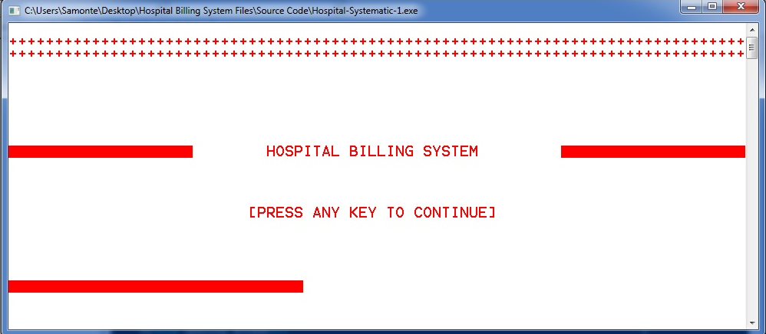
The opening screen
- The title of the system
- And the [PRESS ANY KEY TO CONTINUE] command to the user

Slide 25
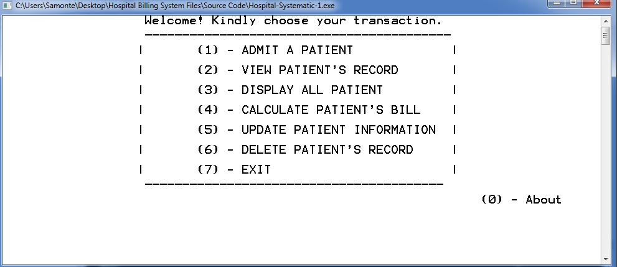
The main menu or screen
- Transaction choices
- 8 choices

Slide 26
SYSTEM TRANSACTIONS
Admit a patient
Viewing patient’s information
Displaying all patient’s (Room & Floor number)
Calculation and discharging of a patient
Updating a patient’s information
Deleting a patient’s information
Termination of the system
About the system

Slide 27
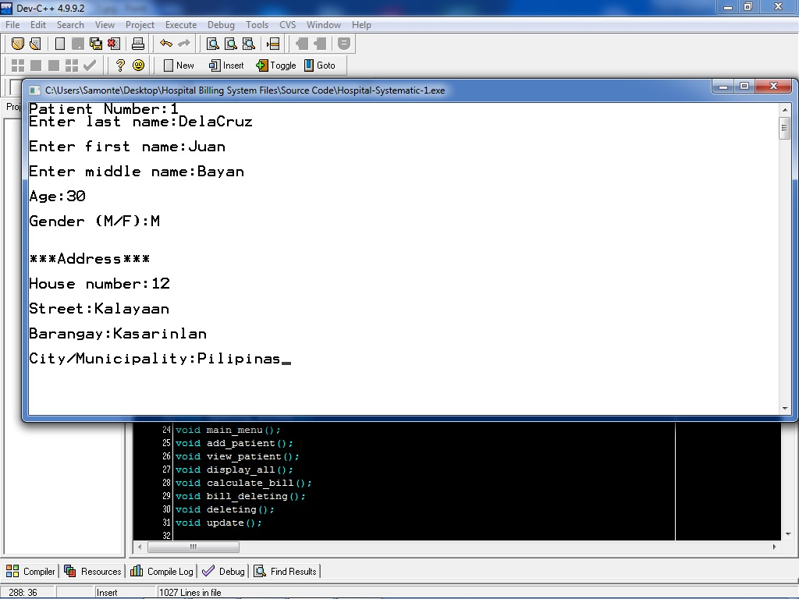
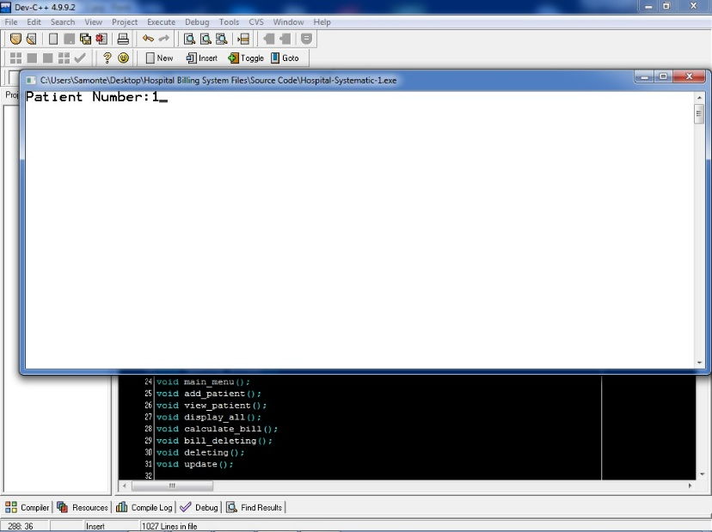

Admitting a patient
Putting the patient’s information

Slide 28

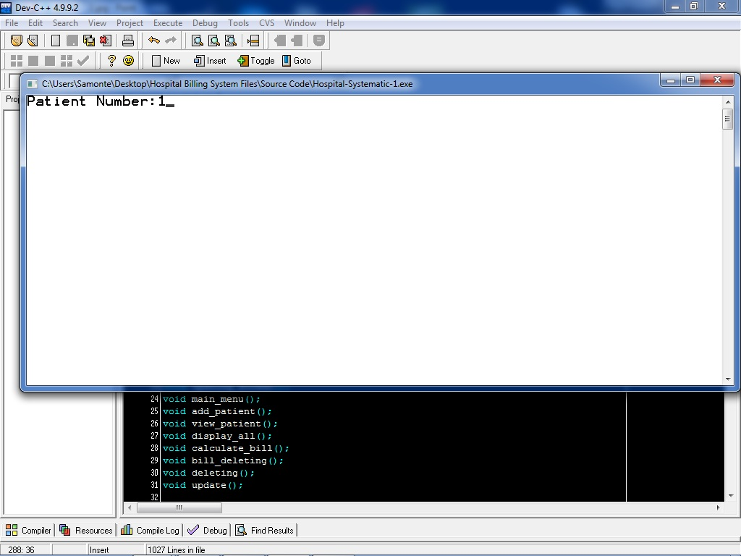

Slide 29
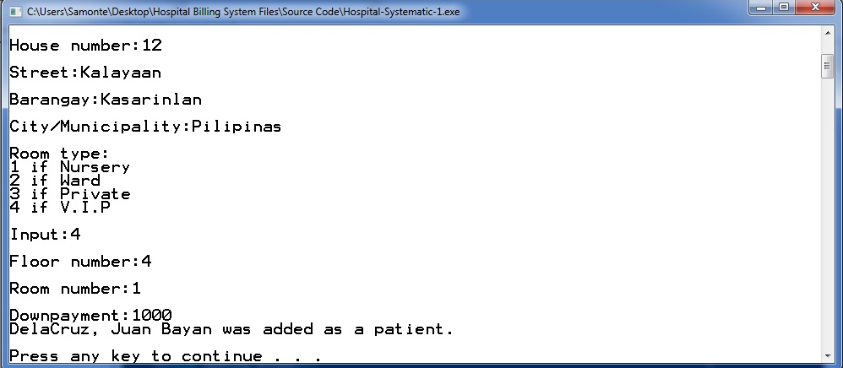

Slide 30
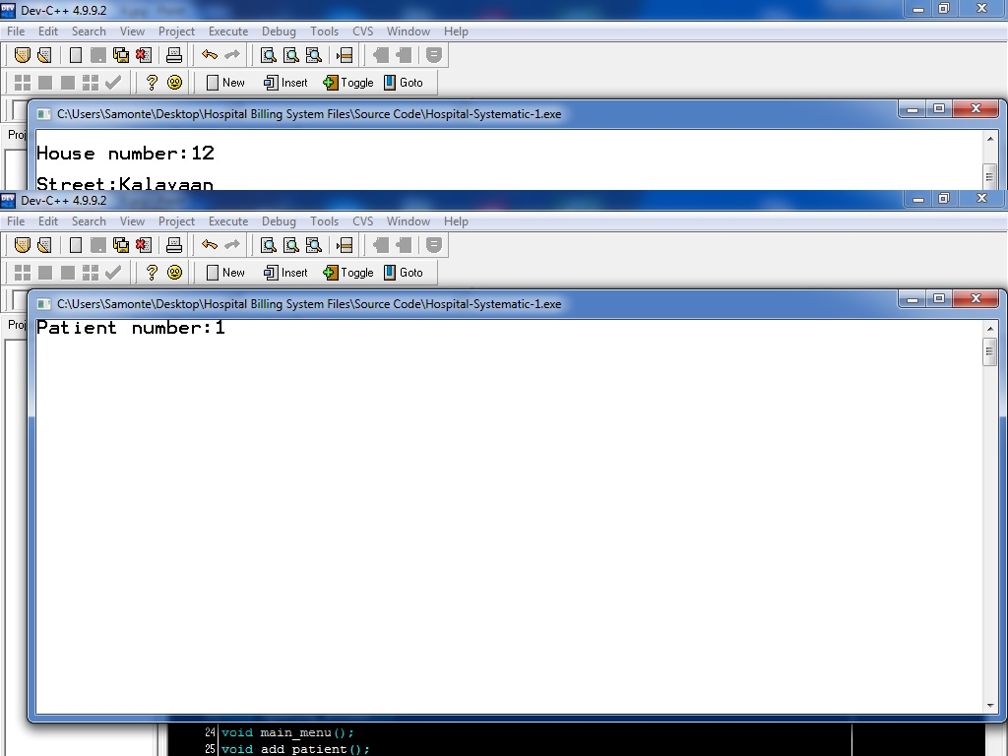
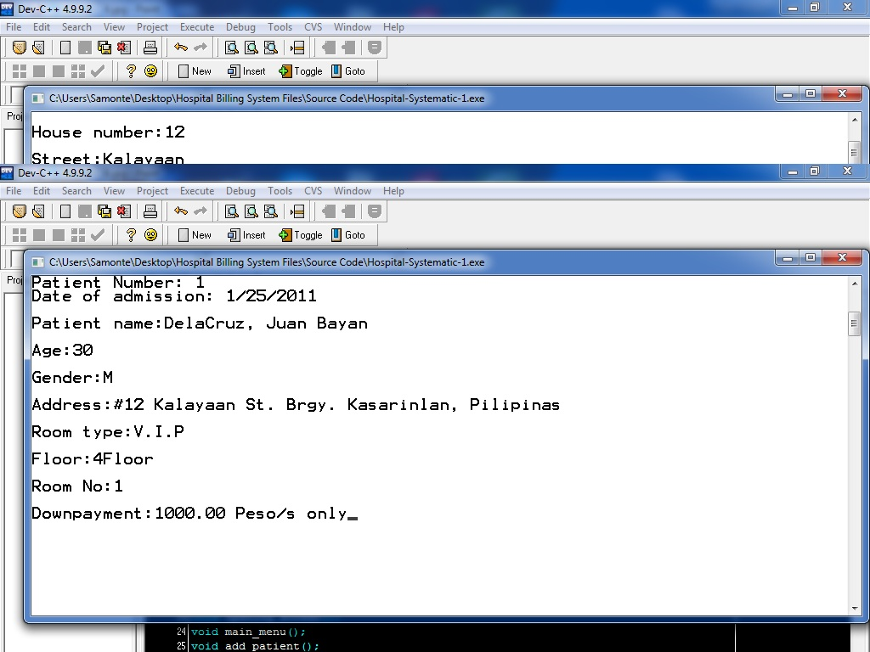
Viewing a patient
Putting the patient’s number
The system will search the patient’s information and will display it.

Slide 33

Displaying all patient
The system will search all of the patient’s information and will display it.

Slide 34
Displaying all patient
The system will search the all of the patient’s information and will display it.

Slide 35
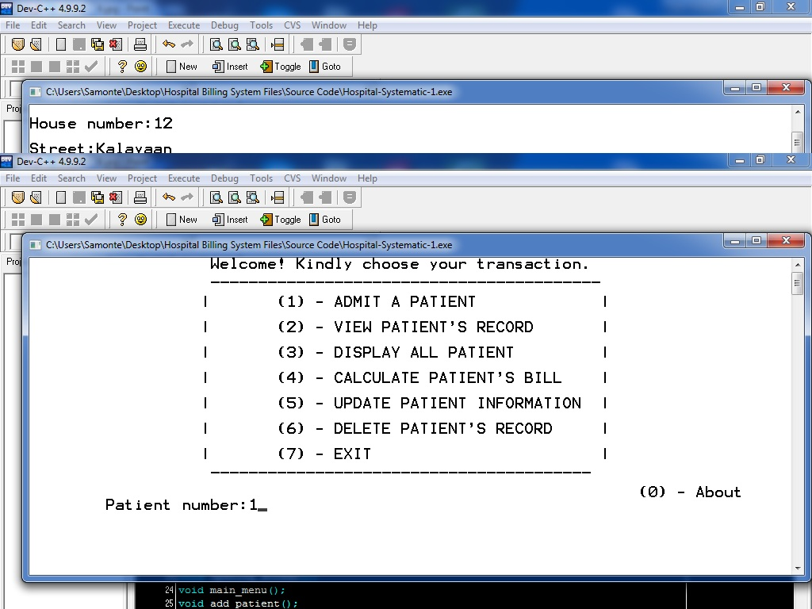
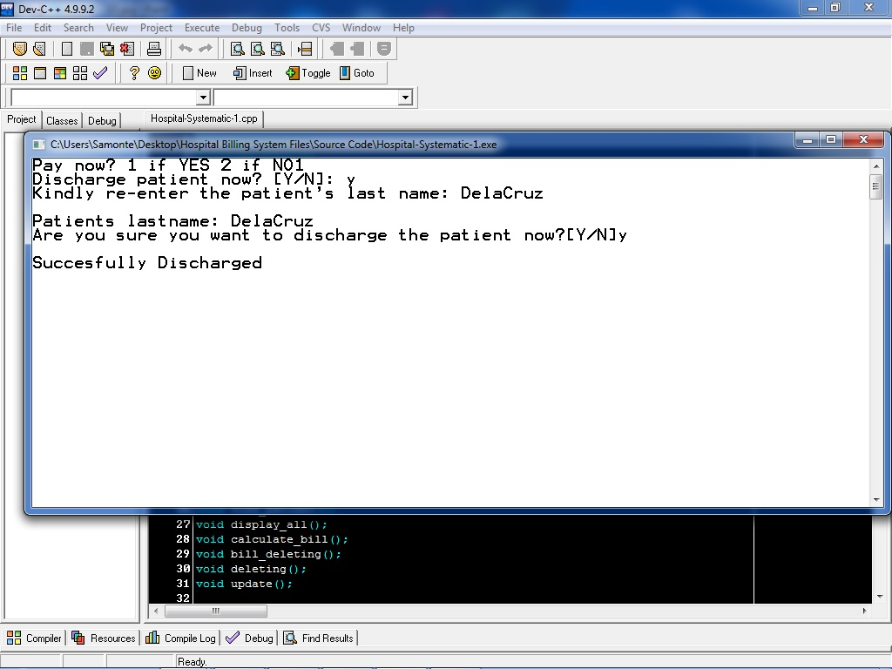
Calculating the bill and discharging a patient
The system will search the patient and ask for all of its expenses and discharging him/her.

Slide 36
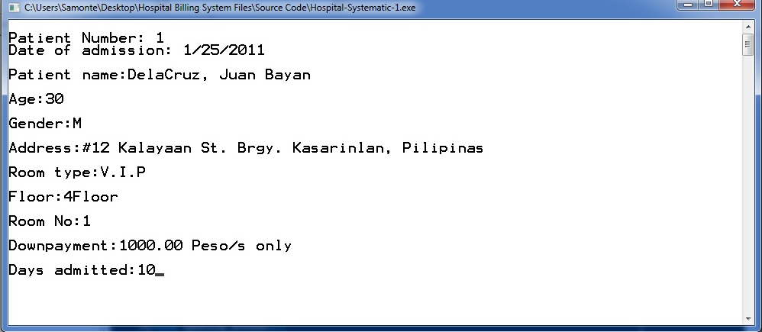

Slide 37


Slide 38
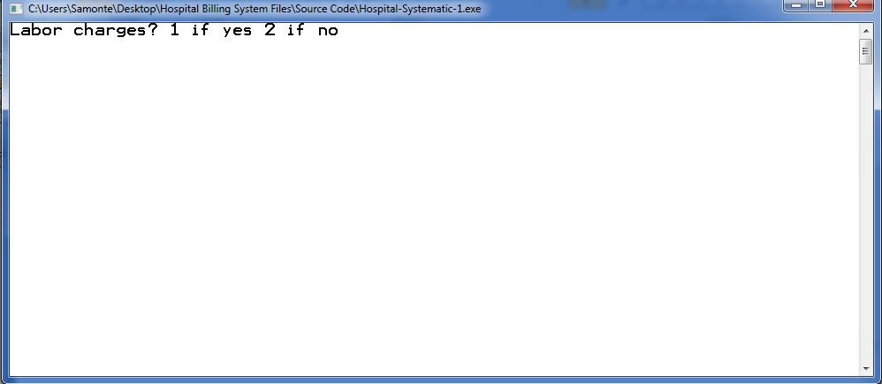

Slide 39


Slide 40
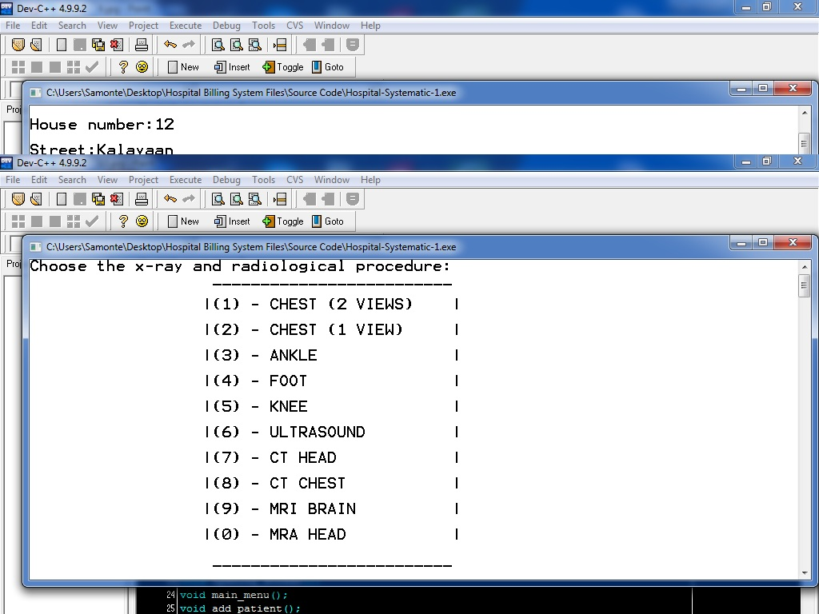
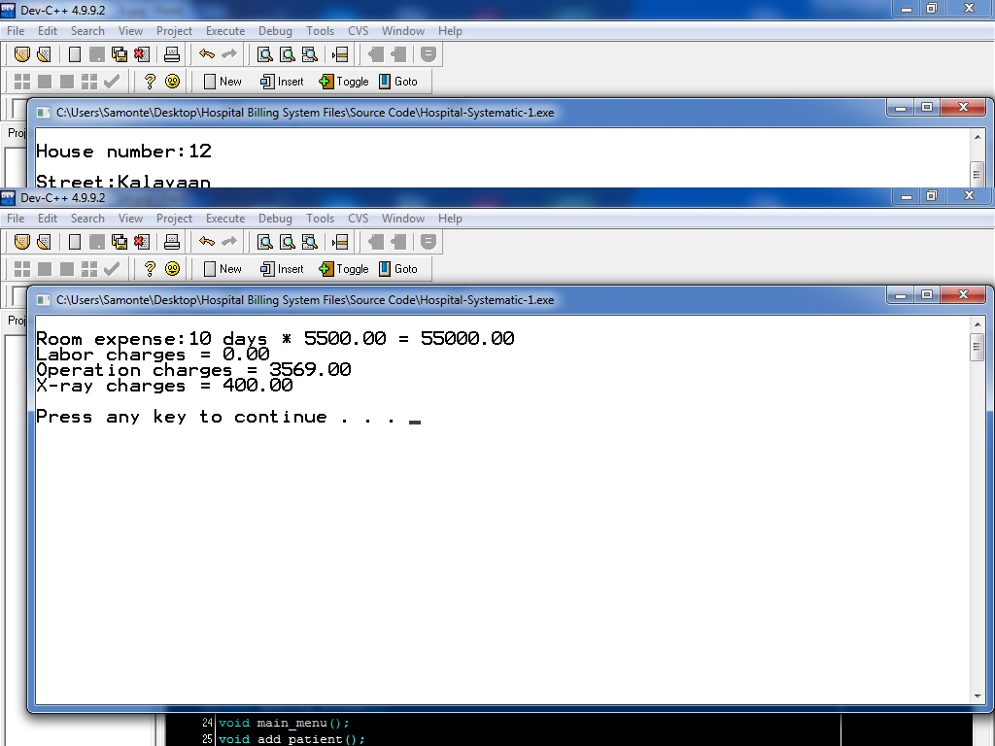

Slide 41
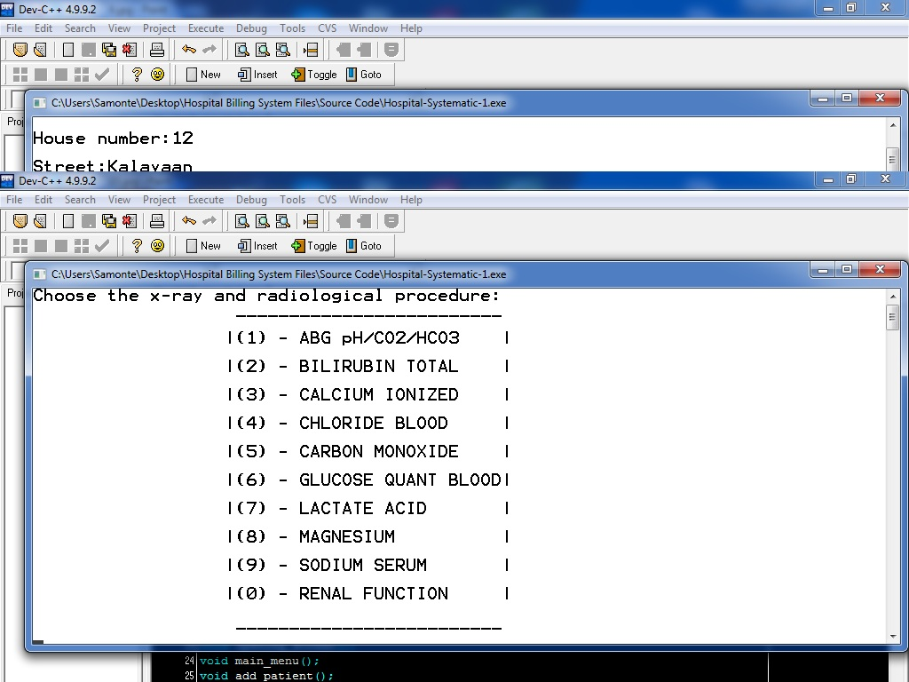
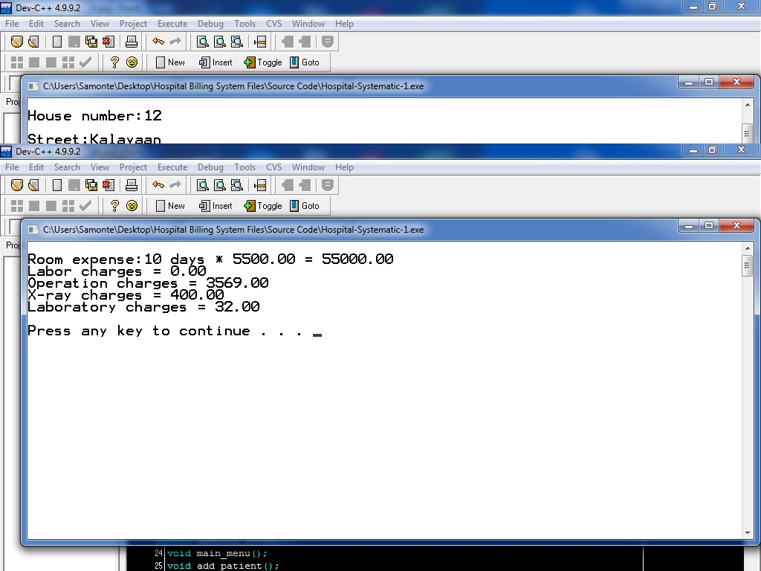

Slide 42

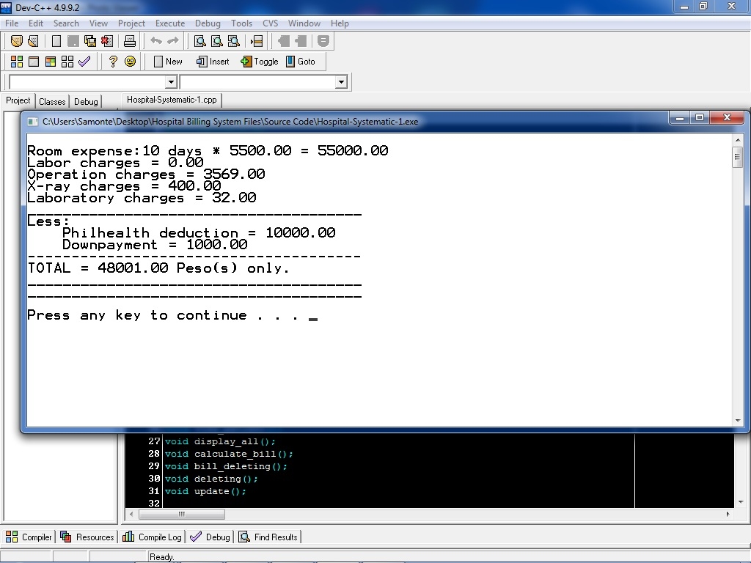

Slide 43
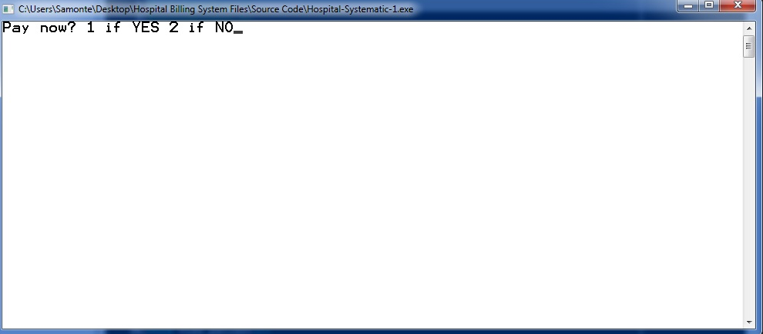

Slide 44
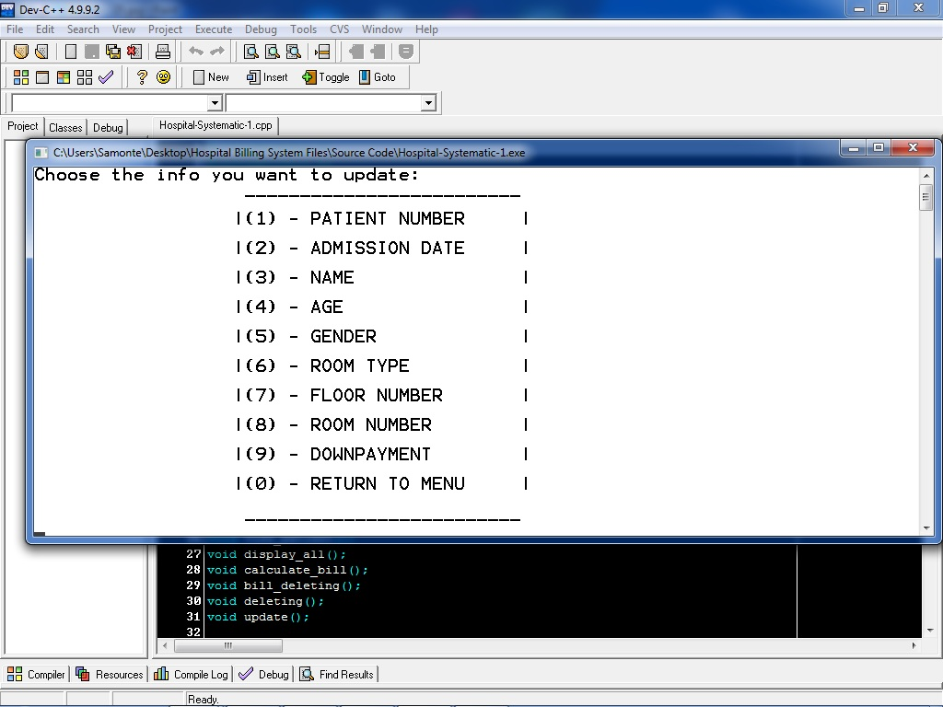
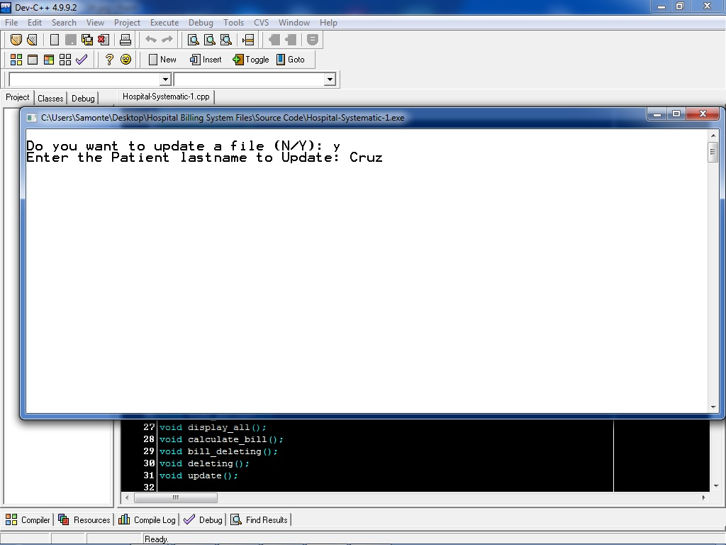
Updating/Editing patient’s information
The system will search the patient and ask the info that want to modified.

Slide 47
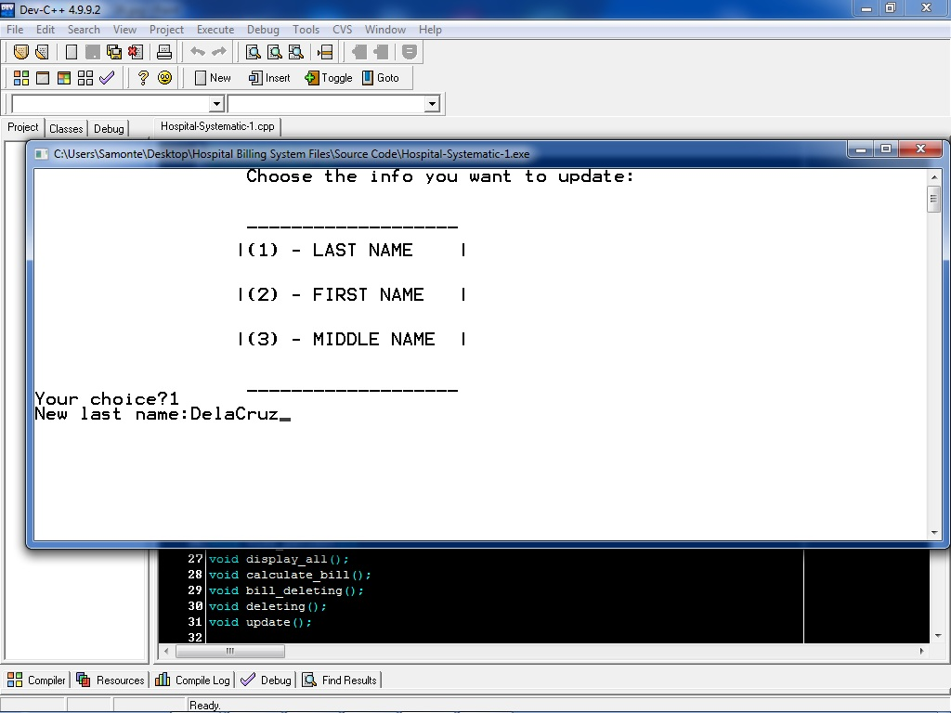
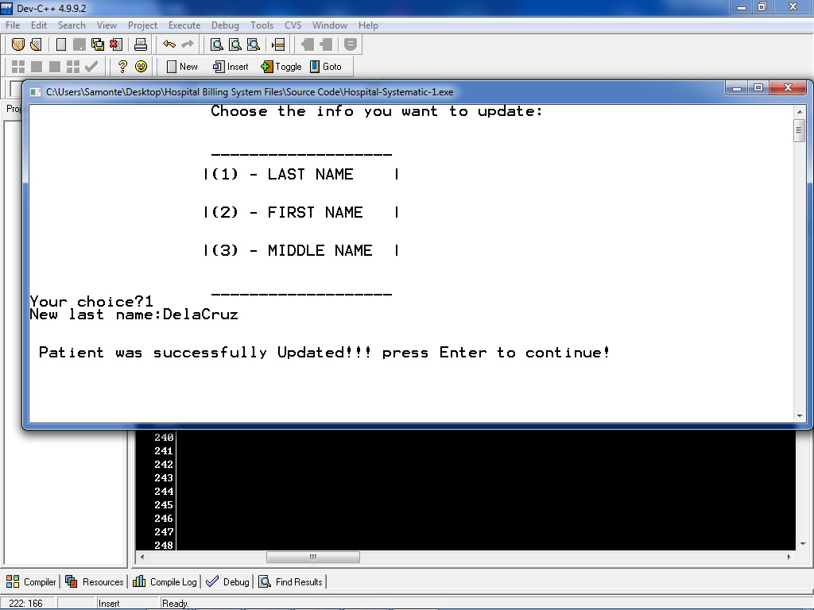

Slide 48
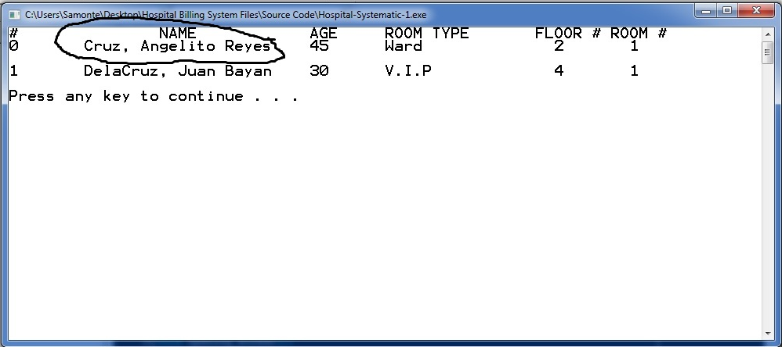
BEFORE

Slide 49
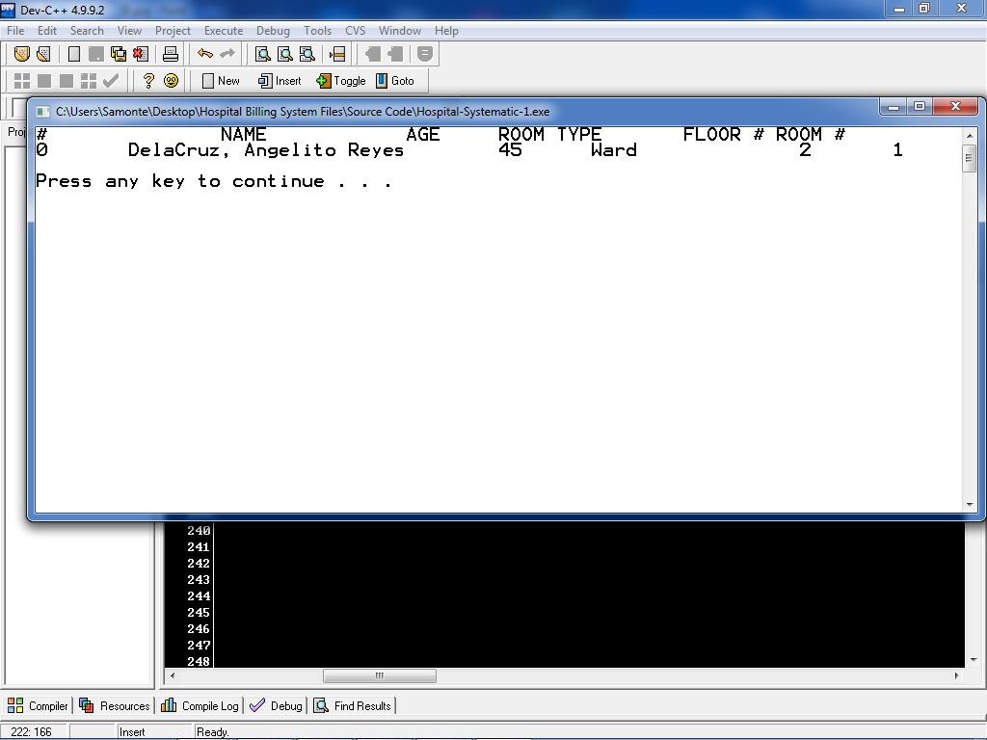
AFTER

Slide 50
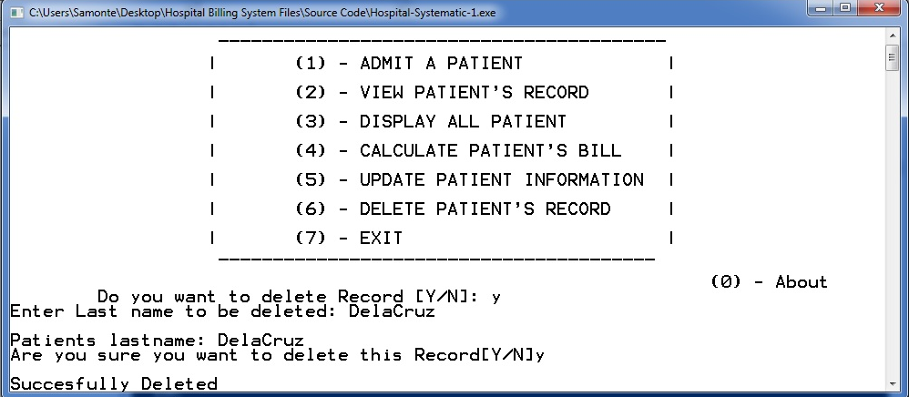
Deleting patient’s information
The system will search the patient and it will delete the patient’s information.

Slide 52
BEFORE

Slide 53

AFTER

Slide 54
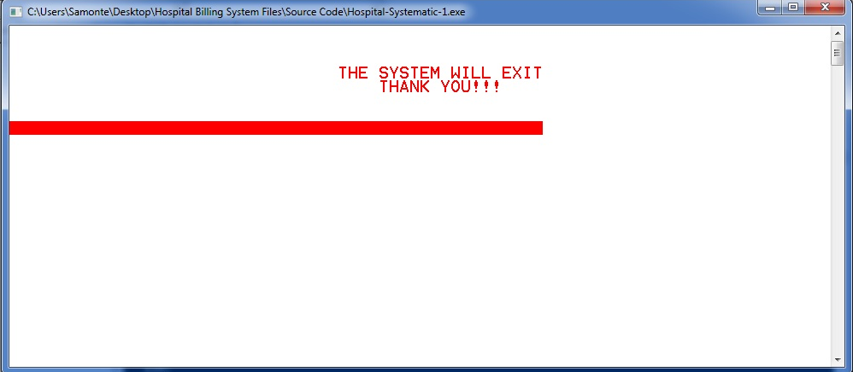
Terminating the system
The system will exit if the user will input ‘Y’ or he/she will input an invalid character.

Slide 55
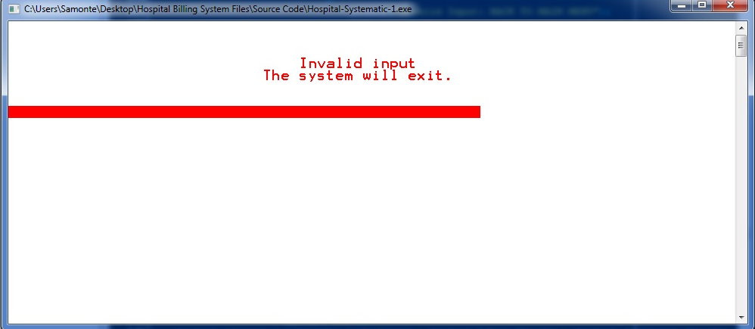
Invalid input

Slide 56
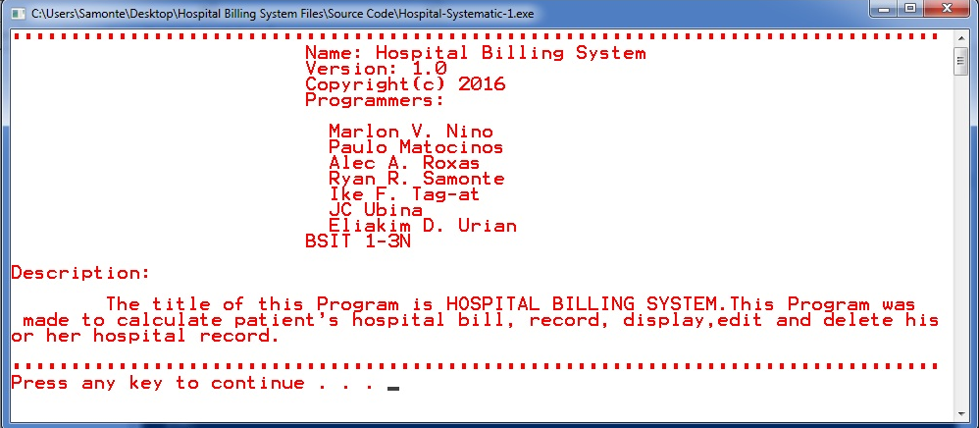
“About” option
The system will display the developers and system description.

Slide 57

Thank You!!! ☻☻☻

